Slide 1


Analysis of Breast Cancer Tableau project
Tiramareddy Manasa Swetha
(U20933669)

Slide 2
Introduction
Breast Cancer is a disease where the cells in the breast grow without any control.
It can begin in different parts of the breast and the kind of cancer depends on the cells that turn into cancer
In 2020, there were 2.3 million women diagnosed with breast cancer and 685000 deaths globally
Breast cancer is the most common cancer in women in the United States, about 13% (about 1 in 8) of U.S. women are going to develop invasive breast cancer during their life
In 2022, an estimated 287,850 new cases of invasive breast cancer are expected to be diagnosed in women in the U.S

Slide 3
Data Sources
Number of people suffering from different cancers data source
country wise cancer death rates from year 1990 to 2017
dataset involved female patients with infiltrating duct and lobular carcinoma breast diagnosed in 2006-2010
classification of tumor classes such as Benign and Malignant based on different factors
data source is based on the number of cancer cases reported in India in 2020

Slide 4
Visualization Analysis

Slide 5
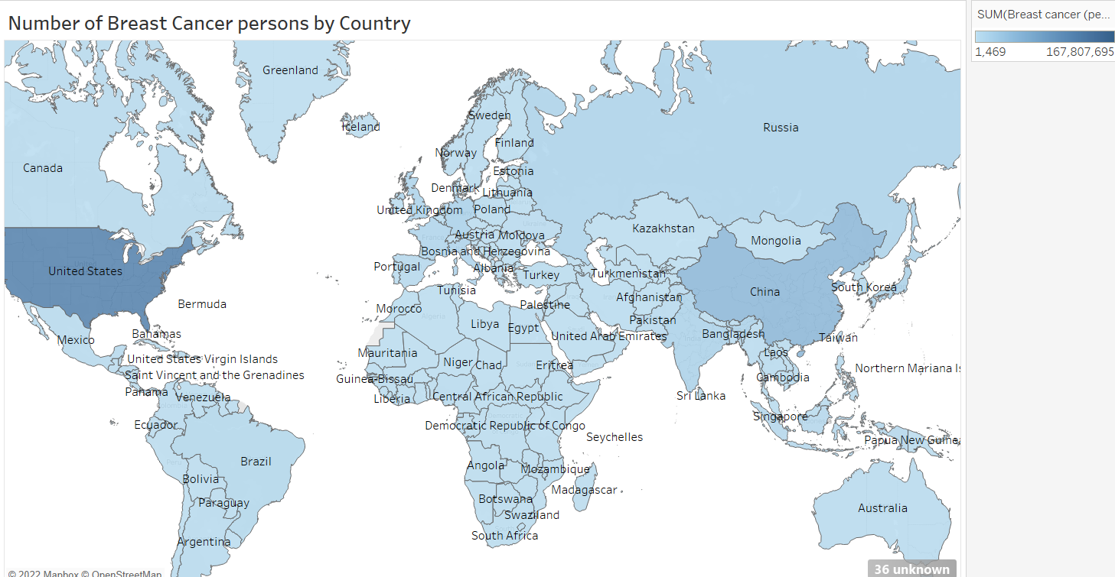

Slide 6
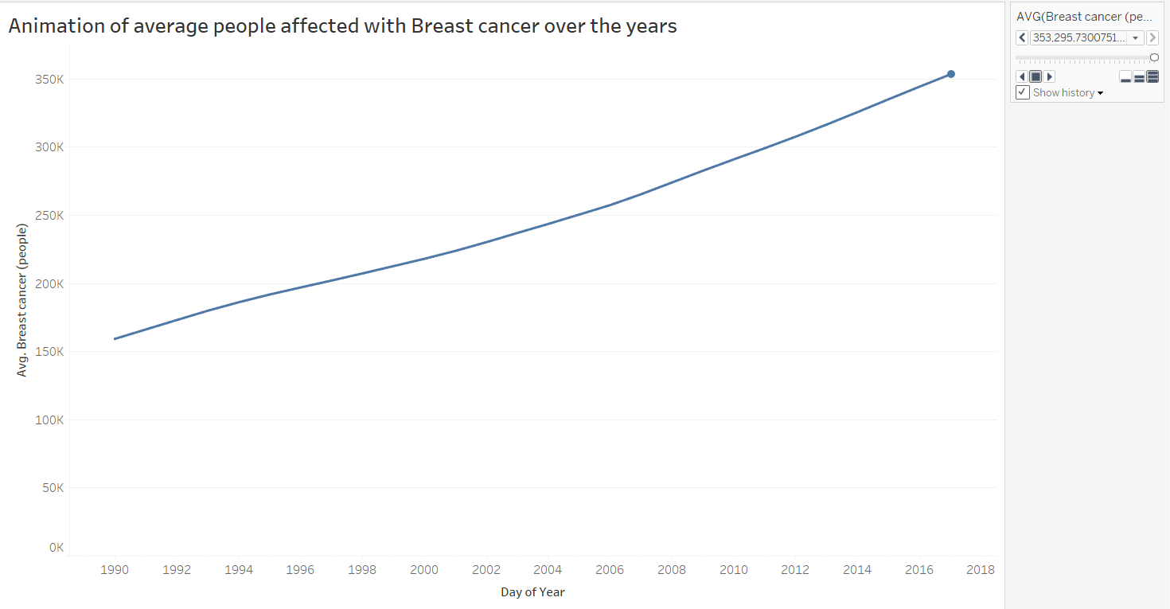

Slide 7
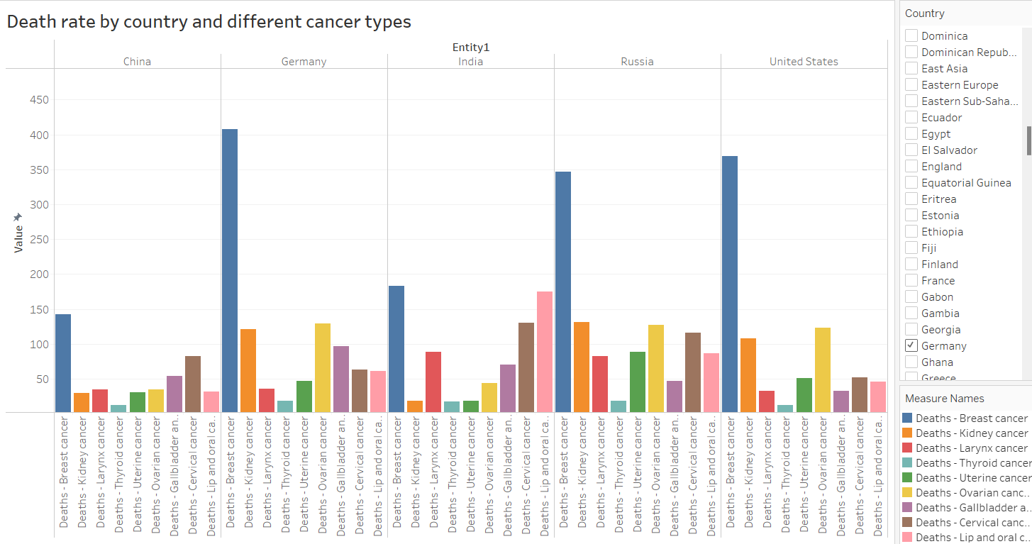

Slide 8
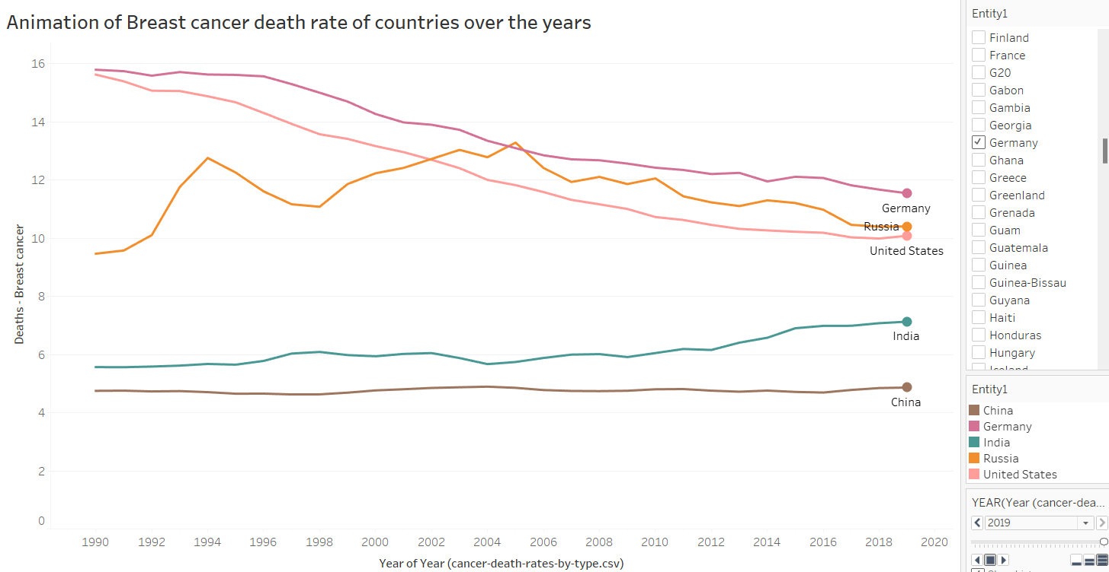

Slide 9
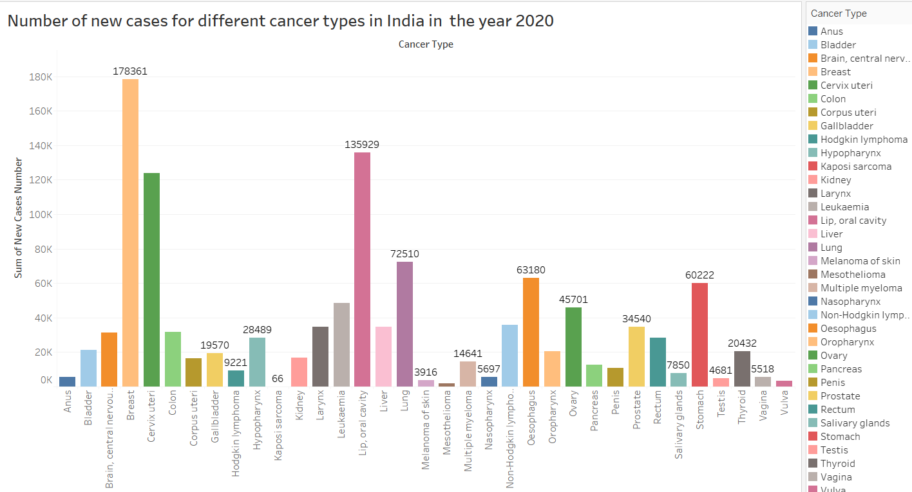

Slide 10
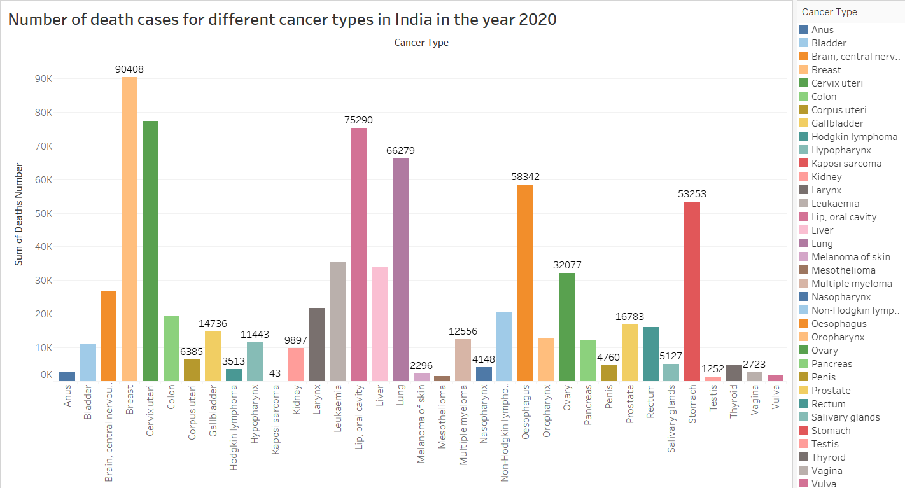

Slide 11
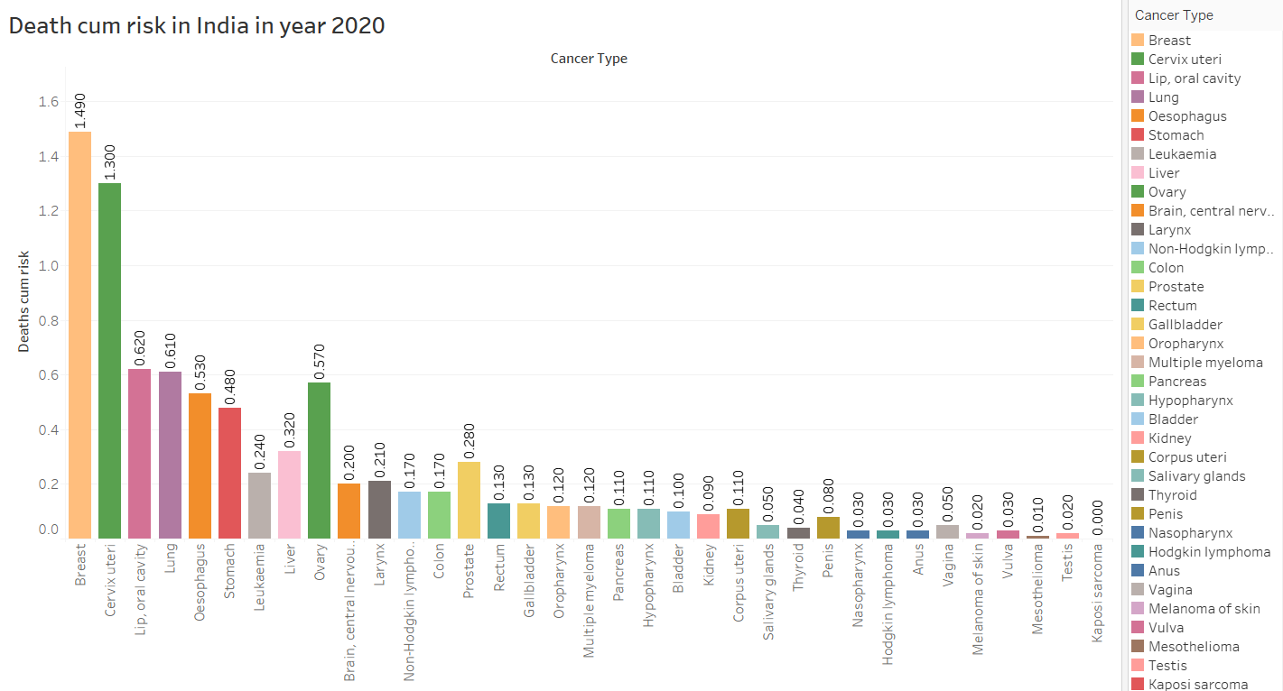

Slide 12
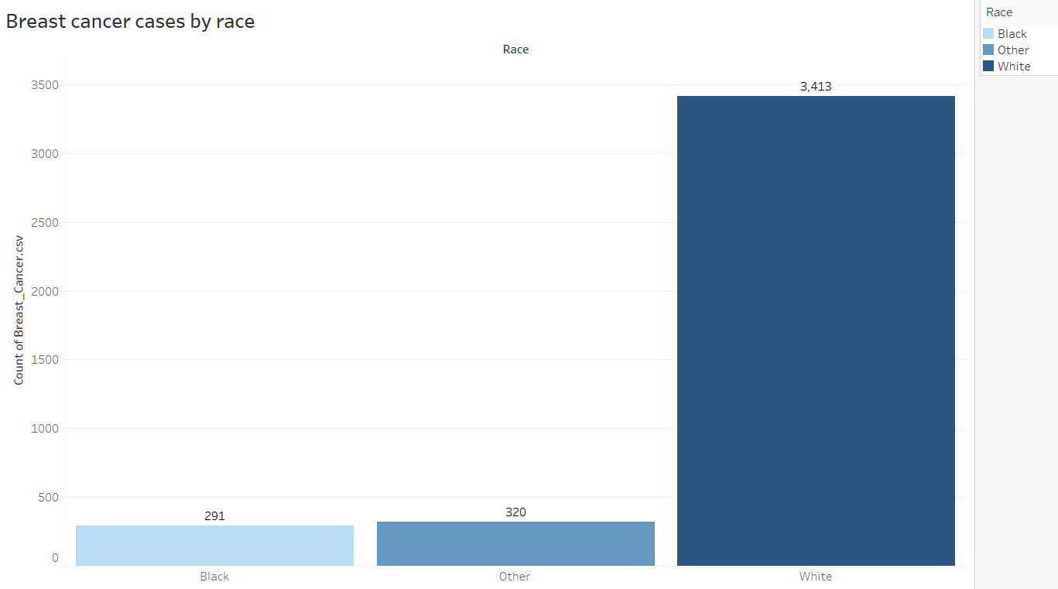

Slide 13
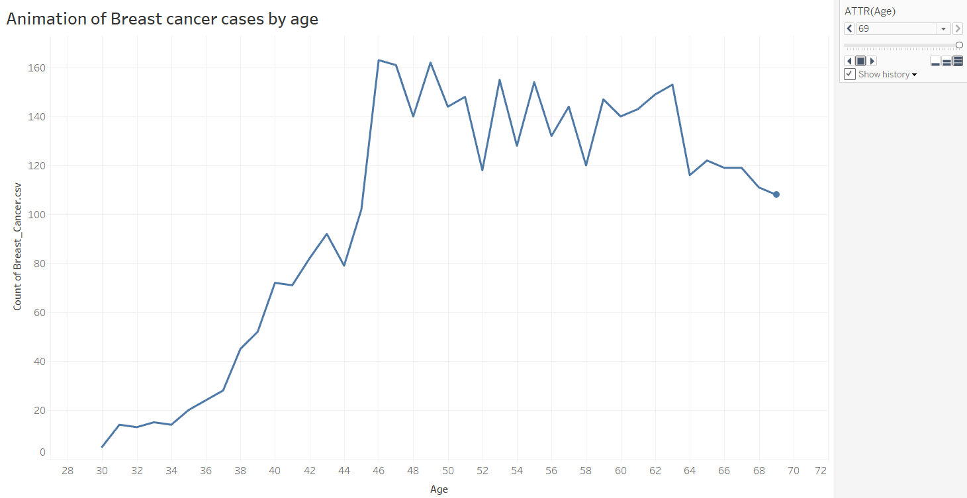

Slide 14
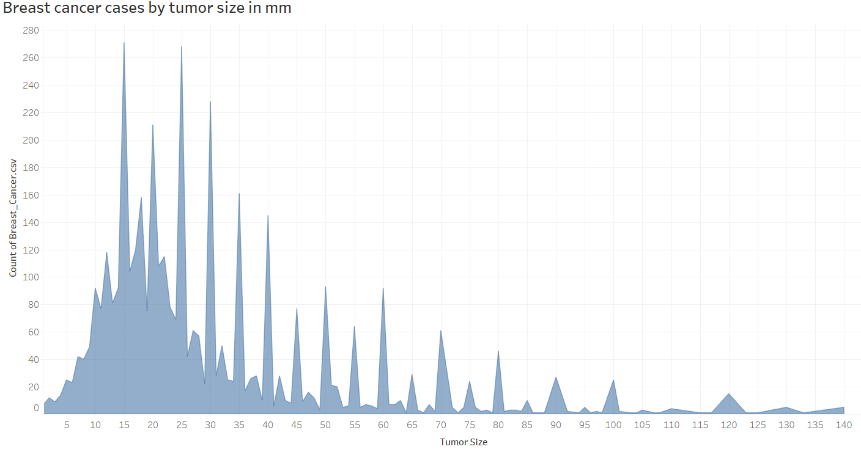

Slide 15
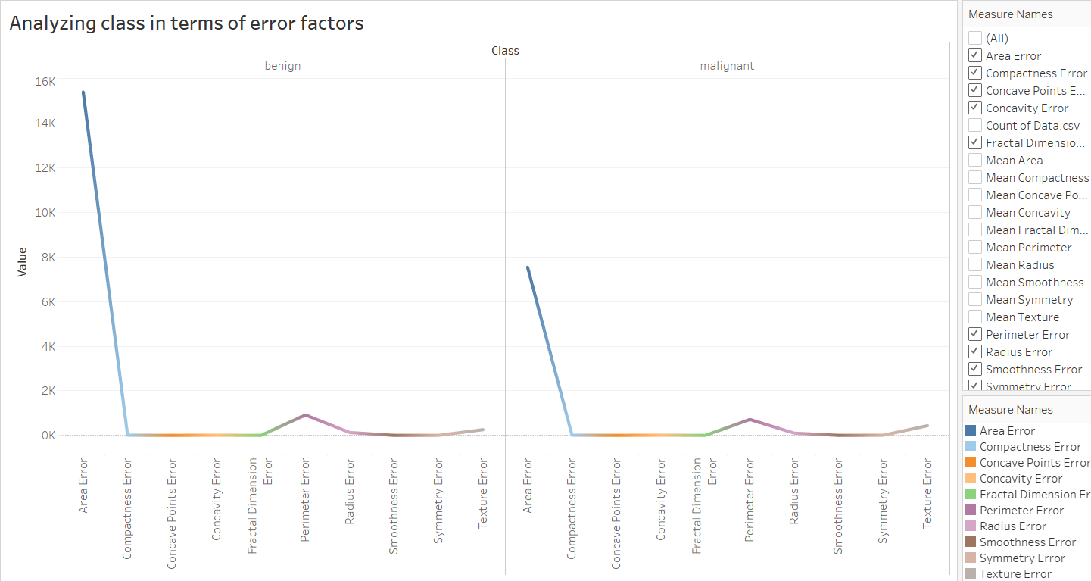

Slide 16
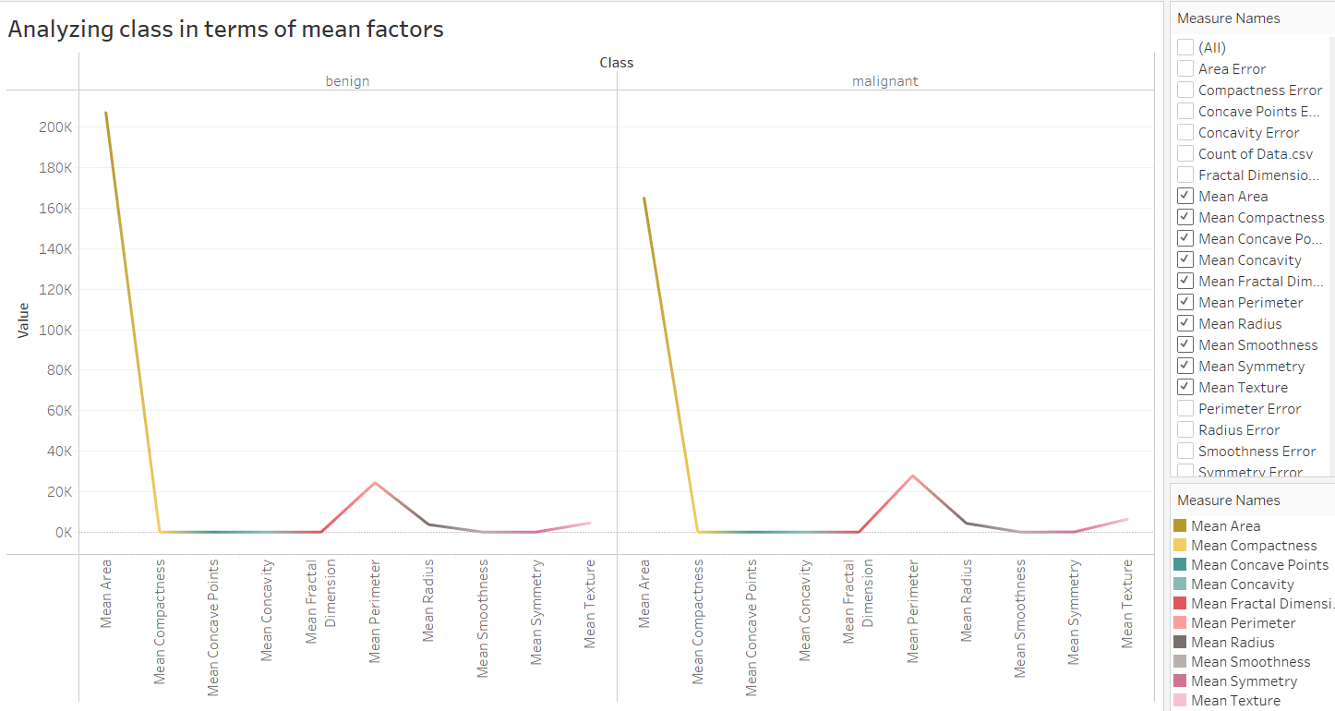

Slide 17
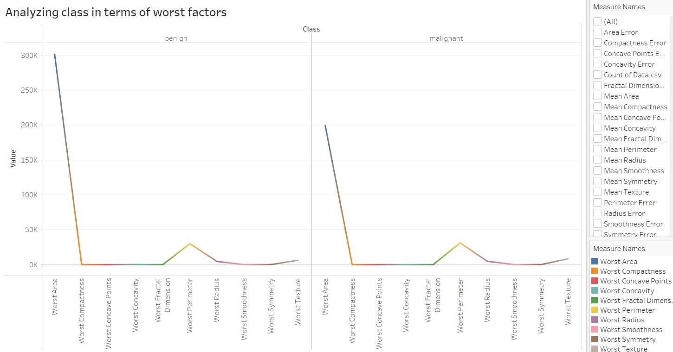

Slide 18
Conclusion
From the above analysis we can conclude that compared to all other cancers Breast cancer has found be the most common cancer and number of people suffering from breast cancer is found to be highest in United states whereas number of death rates is found to be highest in Germany.
From the past few years death rate was decreasing in most of the countries but the new cases kept on increasing mostly for the breast cancer according to the year 2020 data.
We also found from the visualization that white people have a greater number of cases and blacks have a smaller number of cases, by looking into age factor we can see that at age 46 we are observing majority of cases similarly at age 30 we have minimum cases.
Based on tumor size we can analyze that the 15mm tumor size has the count of 271 cases, as the tumor size above 100 mm the count of cases was low.
Finally, we also found how the two different class tumors varying based on the factors.

